Slide 1

INSTITUTE :UIE
DEPARTMENT: ALL ACADEMIC UNITS
Bachelor of Engineering (All Sections)
Subject Name and Code:
Engineering Physics 23SPH-141
Prepared by: Dr. Anjana Sharma, Assistant Prof. Physics
CRYSTALLOGRAPHY & ULTRASONICS
DISCOVER . LEARN . EMPOWER

Slide 2
COURSE OBJECTIVES
The course is designed to make the students industry ready to contribute in the growing demand of the industry at local, national and international level.
It will make the students competent to understand basic concepts and applications of advanced engineering physics and apply its principles in their respective fields at global platform.
It will enhance the skill level of the students and shall make them preferred choice for getting employment in industry and research labs.
It will give thorough knowledge of the discipline to enable students to disseminate knowledge in pursuing excellence in academic areas.

Slide 3
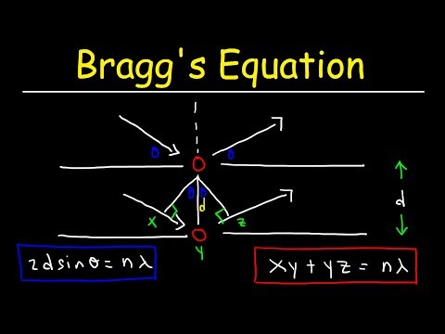
CRYSTAL STRUCTURE
Course Outcome
CO Number | Title On completion of this course, the students are expected to learn | Level
CO1 | Quote the basic fundamental concepts of lasers, optical fibres, crystallography, ultrasonic oscillations, semiconductor physics, quantum mechanics and nanotechnology. | Remember, Understand
CO2 | Demonstrate the working of various lasers, fibre components, semiconductor devices; explain the behaviour of crystalline solids, quantum and nano-scale systems. | Understand
CO3 | Solve problems by applying principles related to lasers, fibres, semiconductors, oscillations, quantum and nanoscience. | Applying
CO4 | Compare various lasers and fibres, semiconducting devices, crystalline materials, structures at quantum and nanoscale on the basis of their properties for industrial applications. | Analyze
CO5 | Develop various systems using lasers, fibres, semiconductors and nanomaterials for futuristic applications. | Design
Fig.1 Braggs Law [1]

Slide 4
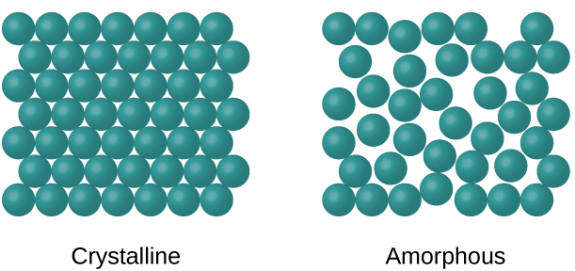
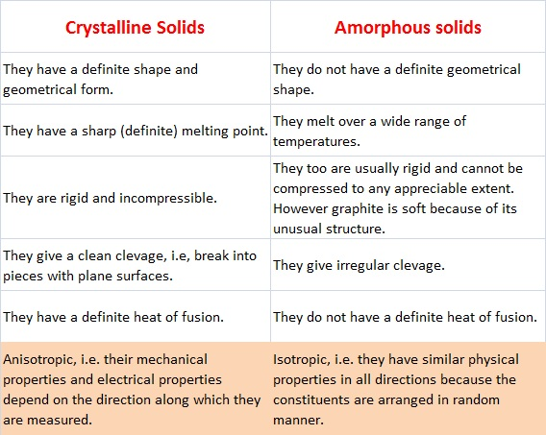
OVERVIEW OF SOLIDS: CRYSTALLINE AND AMORPHOUS

Slide 5
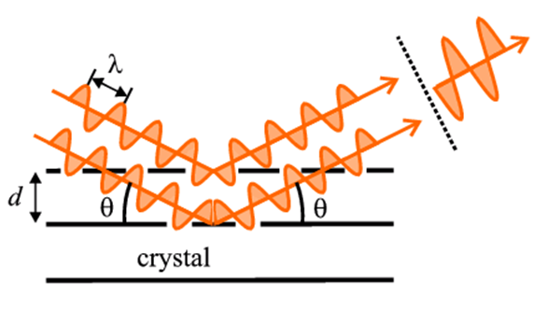
BRAGG’S LAW STATEMENT
Bragg’s law is a special case of Laue diffraction which determines the angles of coherent and incoherent scattering from a crystal lattice. When X-rays are incident on a particular atom, they make an electronic cloud move just like an electromagnetic wave .The movement of these charges radiates waves again with similar frequency, slightly blurred due to different effects and this phenomenon is known as Rayleigh scattering.
The same process takes place upon scattering neutron waves via nuclei or by a coherent spin interaction with an isolated electron. These wave fields which are re-emitted interfere among each other either destructively or constructively creating a diffraction pattern on a film or detector. The basis of diffraction analysis is the resulting wave interference and this analysis is known as Bragg diffraction.
Fig.3 Braggs Diagram [3]

Slide 6
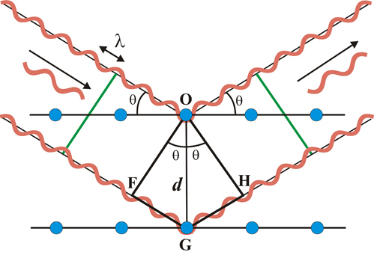
BRAGG’S ANALYSIS
Space for visual (size 24)
In physics, Bragg's law, or Wulff–Bragg's condition, a special case of Laue diffraction, gives the angles for coherent and incoherent scattering from a crystal lattice. The resulting wave interference pattern is the basis of diffraction analysis. This analysis is called Bragg diffraction.
Fig.4 Braggs Diagram [3]

Slide 7
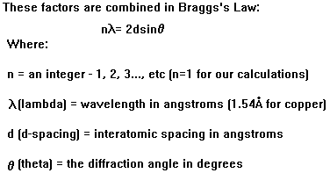
Equation of Bragg’s law

Slide 8
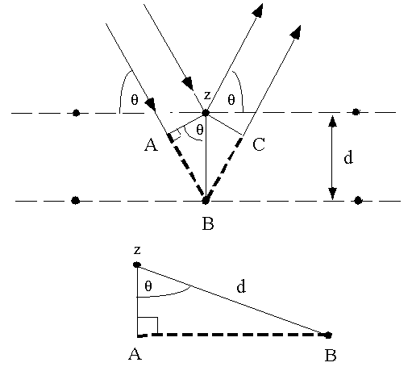
DERIVATION OF BRAGG’S LAW
Bragg considered to be made up of parallel planes of atoms . Incident waves are reflected specially from parallel planes of atoms in the crystal , with each plane reflecting only a very small fraction of the radiation.
BC =d sin𝜃
AB= d sin𝜃
AB+BC= 2 d sin𝜃
nλ = 2 d sin𝜃
Constructive interference of the radiation from successive planes occurs
when the path difference is an integral number of wavelengths. This is the Bragg Law.

Slide 9
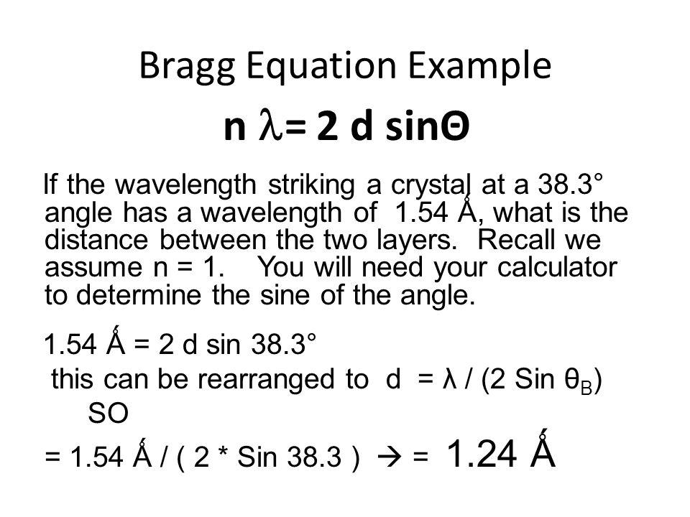
BRAGG EQUATION PROBLEM

Slide 10
APPLICATIONS
Solving Bragg's Equation gives the d-spacing between the crystal lattice planes of atoms that produce the constructive interference. A given unknown crystal is expected to have many rational planes of atoms in its structure. In X-ray diffraction (XRD) the inter-planar spacing (d-spacing) of a crystal is used for Identification and characterization purposes
Computed Tomography (CT) uses many X-ray slices at different angles to build up three dimensional images inside the body with the help of Bragg’s law .
Ultrasound uses echoes from sound waves to locate different organs inside the body, and can be used to monitor the growth of unborn babies.
Magnetic Resonance Imaging (MRI, or NMR) uses powerful magnets to measure the water content of different types of body tissue. It is a slow process, but generates incredibly detailed images of the body.
Positron Emission Tomography (PET) detects radioactive tracers that are injected into the body and Electroencephalography (EEG) detects electrical activity in the brain.

Slide 11

VIDEO

Slide 12
SUMMARY
Introduction to Crystal Structure
Types of Crystal Structure
Bragg’s Law
Application

Slide 13
FAQS
What is difference between Crystalline and Amorphous solid?
What is Motif?
Why powder method is more beneficial than Laue method?
List advantages and disadvantages of Laue Method
What is the significance of Bragg’s law?
What is inverse piezoelectric method?
Draw plot of (100)

Slide 14
REFERENCES
[1]https://www.youtube.com/watch?v=VPCDSmoomGk
[2]https://web.iit.edu/sites/web/files/departments/academic-affairs/academic-resource-center/pdfs/Miller_Indices.pdf
[3] https://www.youtube.com/watch?v=zpRBpSMqJXc
[4] ww4.hcmut.edu.vn/~huynhqlinh/project/Minhhoa3/Nhieuxa/Nx2/www.matter.org.uk/diffraction/x-ray/laue_method.htm
[5]https://web.stanford.edu/group/glam/xlab/MatSci162_172/LectureNotes/04_Powder%20Diffraction,%20Powder%20Method.pdf
[6] https://www.youtube.com/watch?v=zpRBpSMqJXc
[7] https://cdn1.byjus.com/wp-content/uploads/2018/11/physics/2016/10/19094300/Bragg-Equation.png
[8] https://byjus.com/physics/braggs-law/
[9] https://image.slidesharecdn.com/x-raydiffraction-160929024744/95/x-ray-diffraction-5-638.jpg?cb=1475117826

Slide 15
THANK YOU
For queries
Anjana.e1643@cumail.in

